Slide 1

6th Grade Math
Unit 9, Lesson 7 Describing and Interpreting Histograms – Part 2 Volume 2, pg. 179

Slide 2


Benchmark
MA.6.DP.1.4
Given a histogram or line plot within a real‑world context, qualitatively describe and interpret the spread and distribution of the data, including any symmetry, skewness, gaps, clusters, outliers, and the range.
volume 2, pg. 179

Slide 3
Integrated Mathematical Thinking and Reasoning Standards
MA.K12.MTR.5.1 Use patterns and structure to help understand and connect mathematical concepts.
MA.K12.MTR.7.1 Apply mathematics to real-world contexts.
volume 2, pg. 179

Slide 4

Learning Targets
I can describe the shape of a histogram.
I can describe the spread of a data set given a histogram.
I can describe gaps, outliers, and clusters in a histogram.
volume 2, pg. 179

Slide 5

Warm-Up
volume 2, pg. 179

Slide 6


9.7.1 Warm-Up: Math Fail
Discuss with your partner what you notice about this picture.
volume 2, pg. 179

Slide 7

Guided Instruction
volume 2, pg. 180

Slide 8

9.7.2 Guided Instruction: Shape of Distributions
Consider the histogram of the lengths of female sharks.
Shark Length
Frequency
Length (in feet)
volume 2, pg. 180

Slide 9
Shark Length
Sketch an approximate line of symmetry for the histogram.
If the histogram is folded along the line of symmetry, will each half line up perfectly?
volume 2, pg. 180

Slide 10
Do you think all histograms will be symmetrical?
The shape of the shark lengths histogram can be described as symmetric, but histograms can also have other shapes.
volume 2, pg. 180

Slide 11
The histogram displays the number of points per game scored by a college basketball player during the 2008 season.
Discuss with your partner what you notice about the shape of the distribution of points scored per game.
2008 Points per Game
Frequency
Points
volume 2, pg. 181

Slide 12
A right-skewed graph has a longer trail of data to the right and the peak of the data on the left.
volume 2, pg. 181

Slide 13

The time to complete a unit exam for $32$ students is shown on the histogram.
Write an observation about the shape of the distribution of time spent to complete the exam.
Time to Complete a Unit Exam
Frequency
Time (in minutes)
volume 2, pg. 181

Slide 14
A left-skewed graph has a longer trail of data to the left and the peak of the data on the right.
volume 2, pg. 181

Slide 15

Guided Practice
volume 2, pg. 182

Slide 16

9.7.3 Guided Practice: Describing Shape of Distributions
This histogram shows the ages of students in a swimming class.
The shape of the distribution of ages can be best
described as
Swim Class Student Age
Frequency
Age (in months)
symmetric.
right skewed.
left skewed.
volume 2, pg. 182

Slide 17

The histogram shows the length, in millimeters, of $25$ earthworms.
The shape of the distribution of the earthworms’ lengths
can be best described as
Earthworm Length
Frequency
Length (in millimeters)
symmetric.
right skewed.
left skewed.
volume 2, pg. 182

Slide 18

In one study of wild bears, researchers measured the weights, in pounds, of $143$ wild bears that ranged in age from newborn to $15$ years old. The data were used to make this histogram.
Describe the shape of the graph given the context.
Wild Bear Weight
Frequency
Weight (in pounds)
volume 2, pg. 183

Slide 19
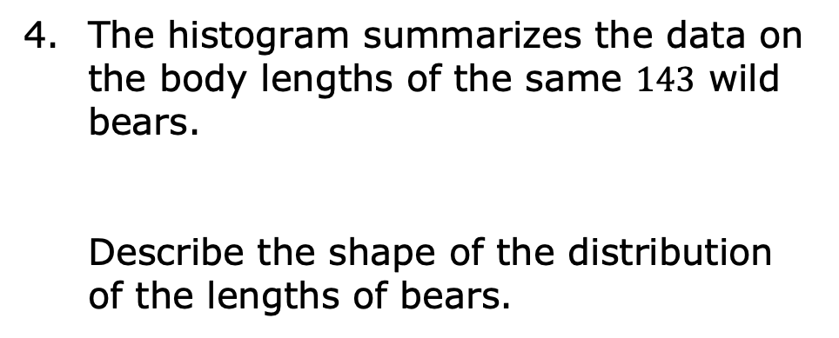
The histogram summarizes the data on the body lengths of the same $143$ wild bears.
Describe the shape of the distribution of the lengths of bears.
Body Length
Frequency
Length (in inches)
volume 2, pg. 183

Slide 20
Guided Instruction
volume 2, pg. 184

Slide 21
9.7.4 Guided Instruction: Features of Histograms
Below are two histograms with different shapes and features.
Histogram A
Histogram B
volume 2, pg. 184

Slide 22
Histogram A
Histogram B
symmetrical
not symmetrical
Histogram A is and has a peak
near _____.
Histogram B is and has
symmetrical
not symmetrical
one peak.
more than one peak.
volume 2, pg. 184

Slide 23

Histogram A
Histogram B
A cluster is formed when data points are in a close group or numerical data have similar values on a number line.
Histogram A
Histogram B
has two clusters.
volume 2, pg. 184

Slide 24
Histogram A
Histogram B
A gap shows a location with no data values. On a histogram, a space between the bins indicates a gap, or a frequency of zero for that bin.
Histogram A
Histogram B
has a gap between ____ and ____.
volume 2, pg. 184

Slide 25
Histogram A
Histogram B
An outlier is a value that is much higher or much lower than the other values in a data set.
12
24
40
If the data value were added to Histogram A, it would be considered an outlier.
volume 2, pg. 184

Slide 26

Collaboration
volume 2, pg. 185

Slide 27

9.7.5 Collaboration: Features of Histograms
Daveed has been tracking the time, in minutes, it takes him to run 4 miles for the last 10 years. A histogram of Daveed’s run times is shown.
Daveed’s Run Times
Frequency
Time (in minutes)
volume 2, pg. 185

Slide 28
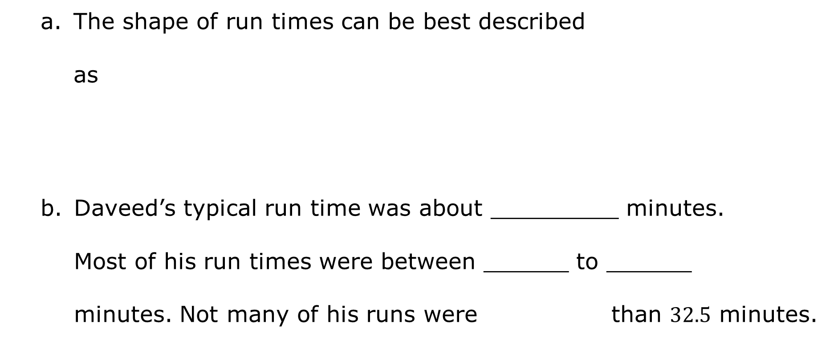
The shape of run times can be best described
as
Daveed’s typical run time was about _________ minutes. Most of his run times were between ______ to ______ minutes. Not many of his runs were than $32.5$ minutes.
symmetrical.
right skewed.
left skewed.
shorter
longer
volume 2, pg. 185

Slide 29
Arya used the data of her $4$-mile run times to create a different histogram.
Arya’s Run Times
Frequency
Time (in minutes)
volume 2, pg. 185

Slide 30
Discuss with your partner what you notice about the interval widths. Determine if there are any unusual features including clusters, gaps, or outliers. Write a detailed description of your discussion.
Arya’s Run Times
Frequency
Time (in minutes)
volume 2, pg. 185

Slide 31
Arya’s Run Times
At what interval in the histogram of Arya’s times is there an outlier?
Would this same data value also be considered an outlier in the histogram of Daveed’s times?
Frequency
Time (in minutes)
volume 2, pg. 186

Slide 32
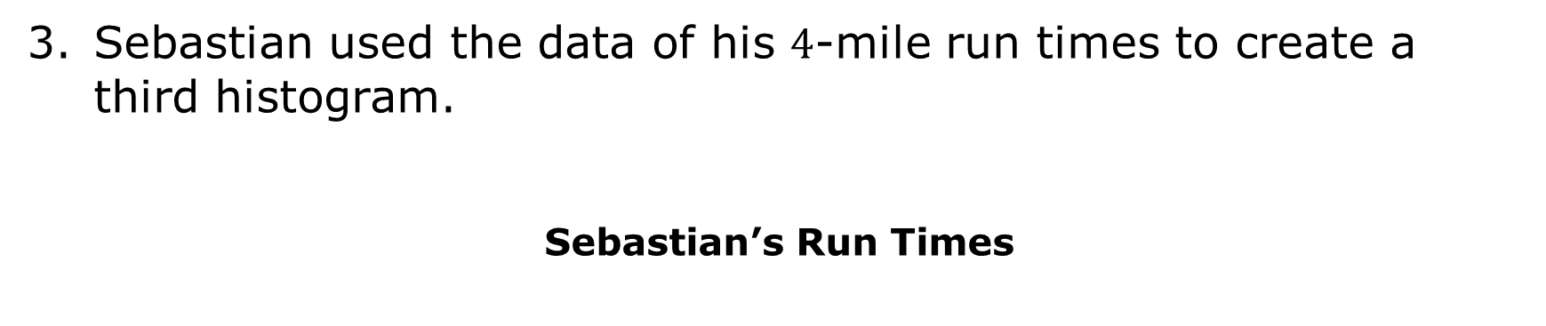
Sebastian used the data of his $4$-mile run times to create a third histogram.
Sebastian’s Run Times
Frequency
Time (in minutes)
volume 2, pg. 186

Slide 33
Which feature is depicted in Sebastian’s histogram?
Describe the spread and shape of the distribution of Sebastian’s run times.
Sebastian’s Run Times
Frequency
Time (in minutes)
volume 2, pg. 186

Slide 34
Different data will change the intervals for the horizontal axis and will affect the histogram and its features: symmetry, skewness, gaps, clusters, outliers, and the range. With your partner, review all three run-time scenarios and discuss the differences between the histograms.
volume 2, pg. 186

Slide 35

Your Turn
volume 2, pg. 187

Slide 36

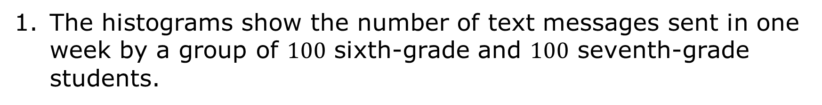
9.7.6 Your Turn!
The histograms show the number of text messages sent in one week by a group of $100$ sixth-grade and $100$ seventh-grade students.
Sixth Graders
Seventh Graders
Frequency
Number of Text Messages
Number of Text Messages
volume 2, pg. 187

Slide 37
Describe the shape of the histogram for the number of text messages sent in one week by sixth-grade students.
Which group of students has the larger spread?
Explain if sixth graders or seventh graders tend to be more alike in terms of the number of text messages they send.
volume 2, pg. 187

Slide 38

Wrap-Up
volume 2, pg. 187

Slide 39

9.7.7 Wrap-Up: Reflection
Place an X on the line to indicate your understanding of parts of analyzing a histogram. Then provide a brief explanation or evidence to support your self-assessment.
I can describe the shape of a histogram.
I can describe gaps, outliers, and clusters in a histogram.
I can describe the spread of a data set given a histogram.
I need help. I can’t get started. | I’m getting there. | I understand and have evidence.
I need help. I can’t get started. | I’m getting there. | I understand and have evidence.
I need help. I can’t get started. | I’m getting there. | I understand and have evidence.
volume 2, pg. 187

